Slide 1
Brew Buddy
Sam Ward
Jacob Boon
Michael Emmerson
Notes:
-Who are we
-What is Brew Buddy
-Project discovery, e.g. we are all brewers/distillers, wanting more from system, don’t want to upgrade. Turns out the market shares that same sentiment.

Slide 2
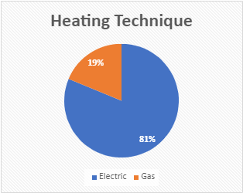
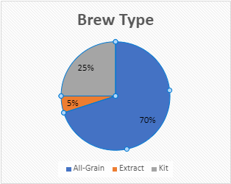
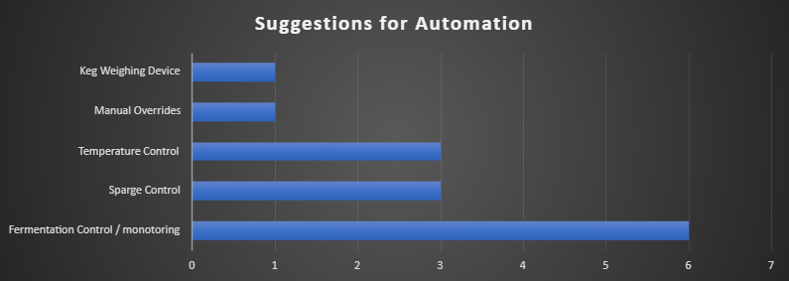
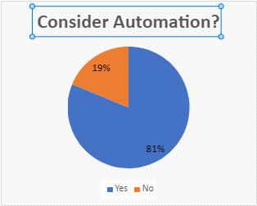
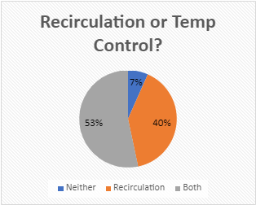
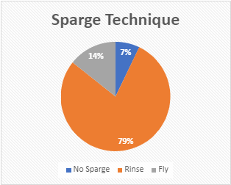
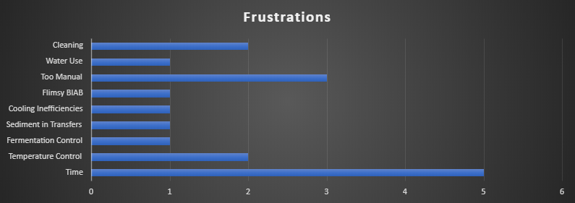
Market Research
Notes:
81% of users indicated they would consider automation

Slide 3
Project Method and Plan
Description | Mar | Apr | May | Jun | Jul | Aug | Sept | Oct
Kick off Meeting | ♦
Project Proposal | ♦
Survey Brewing Club
BCIS Project Proposal |  |  | ♦
Research/Define Requirements |  |  | ♦
BCIS Upskilling
Select & Order Parts
Experimentation
Schematics
Interim Review & Presentation |  |  | ♦
PCB design
Develop Software app
Program Microcontroller
Build, test & development
Revise App
Report writing & documentation
Implementation & Validation
Project Demonstration
Poster Presentation |  |  |  |  |  |  |  | ♦
Final Presentation & Report |  |  |  |  |  |  |  | ♦
Notes:
Project method. Waterfall. Why? Engineering project. You guys don’t know Scrum.
Project contains two elements, combination of software development and electronics engineering

Slide 4
System Design

Slide 5
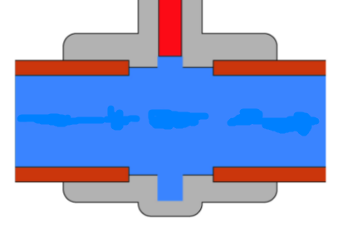
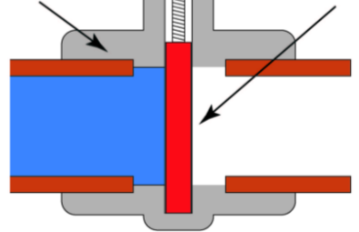

Stage 1: Cleaning (optional)
Valve 3
Mash Tun
Sensor Assembly
Valve 2
Brew Kettle
The waste water is then pumped out of the system and cleaning is complete
Valve 1 will then change inputs and the pump and heater will turn on, pumping hot water throughout the system for a user defined time period
Element
Fill system with water by connecting Input 1 to a household tap
Needle valve
Valve 1 will then open allowing x amount of water into the Brew Kettle
Pump
Valves 2 and 3 will also open to allow sanitisation of the mash tun
Sensor Assembly
Sparge Tank or tap connection
Input 1
Valve 1

Slide 6
Stage 2: Mash
Valve 3
Mash Tun
Sensor Assembly
Valve 2
Brew Kettle
Once strike temperature has been reached, valves 2 and 3 will open allowing hot water to pass through the grains in the mash tun. This step will be different if the user is using an internal grain basket or “Brew in a Bag” method.
Fill system with brewing water by connecting Input 1 to a household tap or “sparge tank” The user will also be prompted to add their grains to the mash tun at this point.
Element
Valve 1 will then open allowing a user defined amount of water into the Brew Kettle.
Make any desired chemical adjustments to the water at this point
Valve 1 will then change inputs and the pump and heater will turn on, pumping hot water throughout the system until the “strike” temperature is reached
Needle valve
The hot “wort” is continually recirculated and the user defined temperature maintained until the mash stage is complete.
Pump
Sensor Assembly
Sparge Tank or tap connection
Input 1
Valve 1

Slide 7
Stage 3: Sparge
Valve 3
Mash Tun
Sensor Assembly
Valve 2
Once the desired amount of sparge water has been delivered to the mash tun, valve 1 switches inputs and the pump and heater element are turned off. The controller will then wait until all sparge water has been drained from the mash tun before proceeding to the next stage.
The user can chose “no sparge” or to input sparge water directly from a household tap, or from a dedicated sparge tank if chemical adjustments to the sparge water are desired
Brew Kettle
Valve 1 then opens allowing sparge water to pass through the grain bed in the mash tun.
Element
Needle valve
The sparge water flow rate is automatically adjusted by varying the needle valve to ensure the correct temperature water is delivered to the grain bed.
Pump
Sensor Assembly
Sparge Tank or tap connection
Input 1
Valve 1

Slide 8
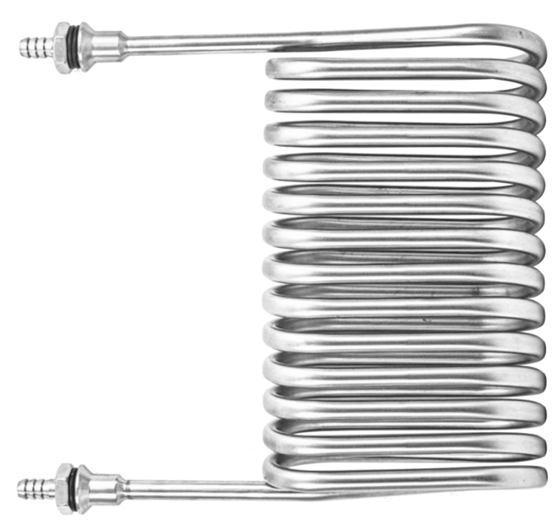
Stage 4: Boil
Valve 3
Mash Tun
Sensor Assembly
Valve 2
Near the end of the boil, valves 2 and 3 will open allowing boiling wort to be passed through the immersion chiller to sanitise it.
Once boiling begins it will continue for as long as the user defined recipe dictates. Prompts will be delivered to the users smart phone when hop and adjunct additions are required.
Brew Kettle
At the beginning of the boil stage valve 2 change outputs and valve 3 will close to isolate the mash tun
Element
Needle valve
The pump and element are then switched on and the wort is heated up to 100°C
Near the beginning of the boil the user will be prompted to disconnect their mash tun and connect an external chiller in its place (if owned)
Pump
Sensor Assembly
Sparge Tank or tap connection
Input 1
Valve 1

Slide 9
Stage 5: Cooling
Valve 3
Sensor Assembly
Valve 2
Brew Kettle
If this temperature is unable to be reached e.g. the cooling water used is at a higher temperature than the target cooling temperature. Then the user will be notified that the cooling process has stalled. They can either select to finish the process there, or adjust the temperature of the cooling water and continue the process.
Multiple options exist for cooling the wort depending on the users equipment and preference. The wort can be cooled by connecting an external cooler (Immersion *shown above*, counterflow or plate chillers) in place of the mash tun, internally by a counterflow chiller or transferred hot to the fermenter and cooled passively.
For safety purposes the user will be prompted to confirm correct fitment of a cooler before proceeding to the cooling stage. If any option other than passive cooling is selected then the pump will then run to recirculate the wort. The system will then attempt to bring the wort to a user defined temperature, notifying the user once this occurs.
Element
Needle valve
Pump
Sensor Assembly
Sparge Tank or tap connection
Input 1
Valve 1

Slide 10
Stage 6: Transfer
Valve 3
Sensor Assembly
Valve 2
Fermenter
Output 1
Brew Kettle
After the cooling phase is complete the pump will turn off. The user will be prompted to ensure output 1 is not below the surface of the wort in the brew kettle. This will allow air to be drawn into the lines and the wort to be drained back into the kettle. (This will drain any wort that is higher than the wort level in the kettle)
At this stage the user can either select a pumped transfer to their fermenter (Kettle Output – Output 1) *shown above* or a manual transfer (valve 1 allows direct pass trough from Kettle Output – Input 1) if the user doesn’t want wort remaining in the lines.
Valve 2 will then change outputs and valve 3 will close with the remaining wort draining back into the kettle.
Element
Needle valve
Pump
Sensor Assembly
Sparge Tank or tap connection
Kettle Output
Input 1
Valve 1

Slide 11
Stage 7: Cleaning
Valve 3
Mash Tun
Sensor Assembly
Valve 2
Brew Kettle
The waste water is then pumped out of the system and cleaning is complete
Valve 1 will then change inputs and the pump and heater will turn on, pumping hot water throughout the system for a user defined time period
Element
Fill system with water by connecting Input 1 to a household tap
Needle valve
Valve 1 will then open allowing x amount of water into the Brew Kettle
Pump
Valves 2 and 3 will also open to allow sanitisation of the mash tun
Sensor Assembly
Sparge Tank or tap connection
Input 1
Valve 1

Slide 12
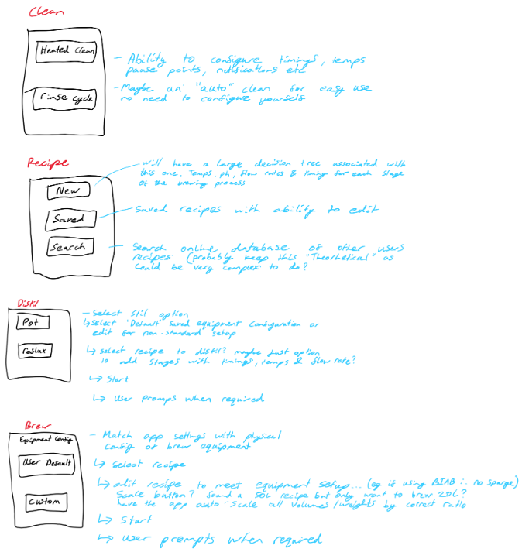
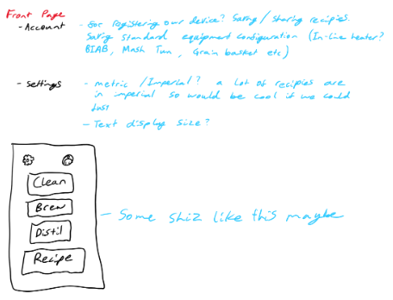

Slide 13
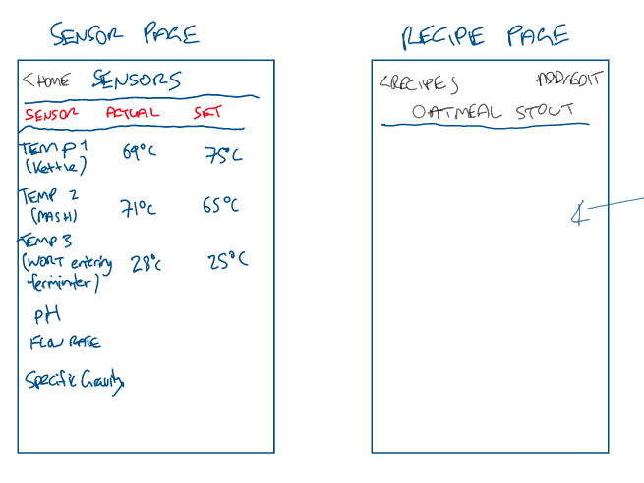
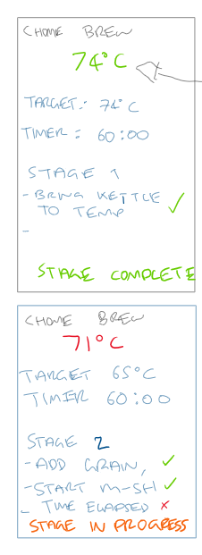
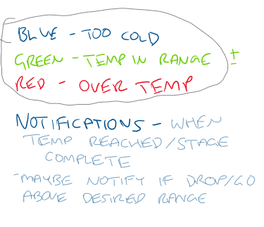
Main info
Mash Stage info
Sparge Stage info
Boil Stage info
Cooling Stage info

Slide 14
Current Project Status
Description | Mar | Apr | May | Jun | Jul | Aug | Sept | Oct
Kick off Meeting | ♦
Project Proposal | ♦
Survey Brewing Club
BCIS Project Proposal |  |  | ♦
Research/Define Requirements |  |  | ♦
BCIS Upskilling
Select & Order Parts
Experimentation
Schematics
Interim Review & Presentation |  |  | ♦
PCB design
Develop Software app
Program Microcontroller
Build, test & development
Revise App
Report writing & documentation
Implementation & Validation
Project Demonstration
Poster Presentation |  |  |  |  |  |  |  | ♦
Final Presentation & Report |  |  |  |  |  |  |  | ♦
Notes:
Project method. Waterfall. Why? Engineering project. You guys don’t know Scrum.
Project contains two elements, combination of software development and electronics engineering

